Slide 1
Sentiment classification under processing constraints
Benchmark accuracy, temporal interpretation and local queueing
M.Sc. Data Science and AI
TweetEval and Bluesky experiments
1
Notes:
Introduce the project as an empirical comparison. Add your name and guide details before presenting. The study uses a Twitter benchmark and a separate Bluesky search sample.

Slide 2
Three questions guide the evaluation
01
How do the models compare on identical labeled posts?
02
How does model choice change the historical sentiment trend?
03
What happens to latency and completed posts as arrivals increase?
2
Notes:
Explain which evidence answers each question. Accuracy is measured only on the labeled Twitter test set.

Slide 3
Two datasets serve different evaluation roles
12,284
127,741
Labeled Twitter test examples
Cleaned Bluesky search posts
45,615 training rows
2,000 validation rows
14 days of AI search results
194 requests reached the result cap
3
Notes:
Source: project CSVs and research/experiment_manifest.json. The search corpus covers 19 October through 1 November 2026 UTC. No manual annotation was conducted.

Slide 4
The comparison includes a simple baseline
01
VADER supplies the rule-based baseline.
02
TF-IDF with logistic regression tests a low-cost learned model.
03
BiLSTM and Twitter RoBERTa supply the neural comparisons.
4
Notes:
Source: sentiment/benchmark.py and sentiment/rain_bilstm.py. VADER and RoBERTa are off-the-shelf. Training histories differ. BiLSTM scores use saved predictions because TensorFlow import is blocked.

Slide 5
The implementation keeps evidence traceable
Collect and filter
Classify posts
Store in SQLite
Aggregate over time
Saved predictions, source hashes and timing records support reproduction.
5
Notes:
Source: db.py and sentiment/replay_benchmark.py. The live collector includes filtering. Controlled replay begins from stored cleaned text and excludes live transport.

Slide 6
RoBERTa leads the labeled benchmark
Score on a 0–1 scale. Neutral majority accuracy is 0.483.
6
Notes:
Source: research/benchmark/*_metrics.json. All models use the same 12,284 local test rows. RoBERTa accuracy is 72.18% and macro F1 is 0.724. BiLSTM uses saved predictions.

Slide 7
Small score differences need uncertainty
01
RoBERTa accuracy interval is 71.38% to 72.95%.
02
The TF-IDF versus BiLSTM accuracy-difference interval includes zero.
03
BiLSTM misses many negative examples by assigning neutral.
7
Notes:
Source: research/benchmark/uncertainty.json. Paired bootstrap uses 1,000 resamples, seed 42, and assumes independent rows.

Slide 8
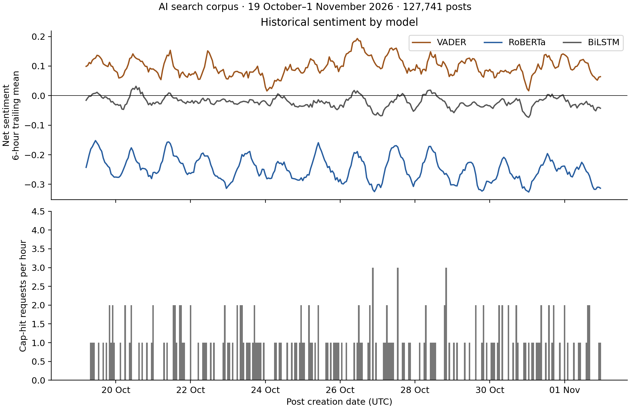
Classifier choice changes the temporal signal
8
Notes:
Source: research/temporal/summary.json and sentiment_h.csv. The plotted lines are six-hour trailing means. Opposite-sign counts use raw hourly net sentiment. VADER and RoBERTa differ in sign in 327 of 336 hours.

Slide 9
Inference cost depends on batching and workload
26.45 ms
59.60 posts/s
RoBERTa median run p50
for a single-post call
RoBERTa median throughput
with batches of eight
These measurements describe warm local inference on the fixed test sample.
9
Notes:
Source: research/runtime/summary.csv. Fixed sample of 96 test posts, three repeats, CPU, four PyTorch threads. Median of run-specific metrics. Excludes queueing and storage.

Slide 10
Controlled replay exposes queue overflow
Model | Offered posts/s | Stored of 288 | Dropped of 288
VADER | 10 | 288 | 0
VADER | 40 | 288 | 0
VADER | 80 | 288 | 0
RoBERTa | 10 | 191 | 97
RoBERTa | 40 | 79 | 209
RoBERTa | 80 | 72 | 216
Latency of completed posts must be interpreted alongside dropped arrivals.
10
Notes:
Source: research/replay/summary.json. Each condition offers 288 posts across three short runs. One worker, batch one, waiting capacity 16, actual SQLite commits. Network and filtering are excluded.

Slide 11
The findings have explicit boundaries
01
Bluesky labels are unverified, and search coverage is incomplete.
02
Pretraining histories differ, and bootstrap assumes independent rows.
03
Short local replay omits live delivery and long-running system effects.
11
Notes:
Explain these limitations directly in viva. The report does not claim Bluesky accuracy or production capacity. TensorFlow import prevents fresh BiLSTM timing.

Slide 12
The study connects model quality with monitoring behaviour
01
RoBERTa has the highest observed labeled benchmark scores.
02
The same historical posts produce different sentiment directions.
03
Processing constraints affect which arriving posts reach storage.
12
Notes:
Sources: dissertation Chapters 5 and 6. Related work includes TweetEval, TimeLMs, CognitiveSky and BlueTempNet. Cite full references in the dissertation. Publication requires venue-specific review.

